Slide 1
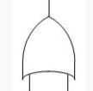
AFT of High Pollution
High Pollution
Particular exposure to Air, water, land
Pollution control Device malfunction / fault
Electrical fault
Mechanical fault
Fuse Burn
Wire Burn
Software crash
Gear broken
Shaft/
spindle broken

